Slide 1
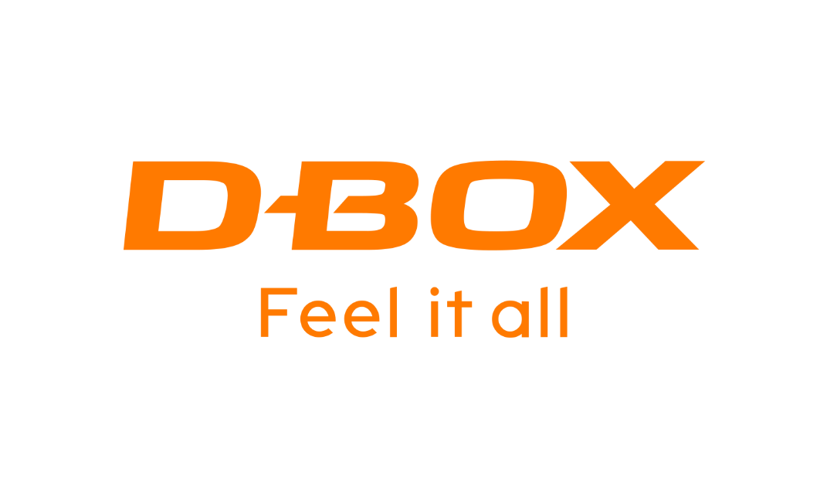
TSX: DBO
Investor Presentation
June 2024

Slide 2
Disclaimer
Caution Regarding Forward-looking Information
This presentation contains statements that may constitute “forward-looking information” within the meaning of applicable Canadian securities legislation. Forward-looking information may include, among others, statements regarding the future plans, activities, objectives, operations, strategy, financial performance and condition of the Corporation, or the assumptions underlying any of the foregoing. In this presentation, words such as “may”, “would”, “could”, “will”, “likely”, “believe”, “expect”, “anticipate”, “intend”, “plan”, “estimate” and similar words and the negative form thereof are used to identify forward-looking statements. Forward-looking statements should not be read as guarantees of future performance or results, and will not necessarily be accurate indications of whether, or the times at or by which, such future performance will be achieved. No assurance can be given that any events anticipated by the forward-looking information will transpire or occur. Forward-looking information is based on information available at the time and / or Management's good-faith belief with respect to future events and are subject to known or unknown risks, uncertainties, assumptions and other unpredictable factors, many of which are beyond the Corporation’s control. These risks, uncertainties and assumptions include, but are not limited to, those described under “Risk Factors” in the Corporation’s Annual Information Form for the fiscal year ended March 31, 2024, a copy of which is available on SEDAR+ at www.sedarplus.ca and could cause actual events or results to differ materially from those projected in any forward-looking statements. The Corporation does not intend, nor does the Corporation undertake any obligation, to update or revise any forward-looking information contained in this presentation to reflect subsequent information, events or circumstances or otherwise, except if required by applicable laws.
Market and Industry Data
Market and industry data presented throughout this presentation was obtained from third-party sources, industry reports and publications, websites and other publicly available information, as well as industry and other data prepared by us or on our behalf, on the basis of our knowledge of the markets in which we operate, including information provided by other industry participants. We believe that the market and industry data presented throughout this presentation is accurate and, with respect to data prepared by us or on our behalf, that our opinions, estimates and assumptions are currently appropriate and reasonable, but there can be no assurance as to the accuracy or completeness thereof. The accuracy and completeness of the market and industry data presented throughout this presentation are not guaranteed and the Corporation makes no representation or warranty, express or implied, as to the accuracy of such data and no reliance should be placed on, the fairness, accuracy, completeness or correctness of the market and industry data or any other information or opinions contained herein, for any purpose whatsoever. Actual outcomes may vary materially from those forecast in such reports or publications, and the prospect for material variation can be expected to increase as the length of the forecast period increases. Although we believe it to be reliable, the Corporation has not independently verified any of the data from third-party sources referred to in this presentation, analyzed or verified the underlying studies or surveys relied upon or referred to by such sources, or ascertained the underlying market, economic and other assumptions relied upon by such sources. Market and industry data is subject to variations and cannot be verified due to limits on the availability and reliability of data inputs, the voluntary nature of the data gathering process and other limitations and uncertainties inherent in any statistical survey.
Currency
All references in this presentation to dollars and “$” are to Canadian dollars unless otherwise specified.
2

Slide 3
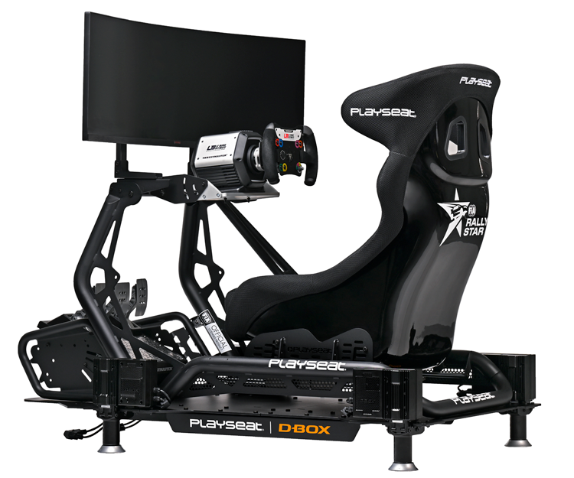
Investment Highlights
D-BOX makes entertainment and training more realistic and immersive
Innovative haptic technology allows users to feel motion, vibration, and texture

Slide 4
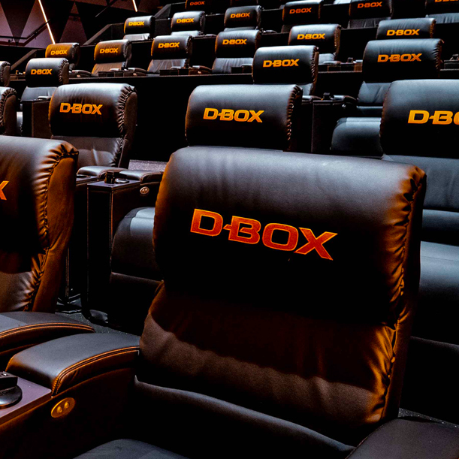
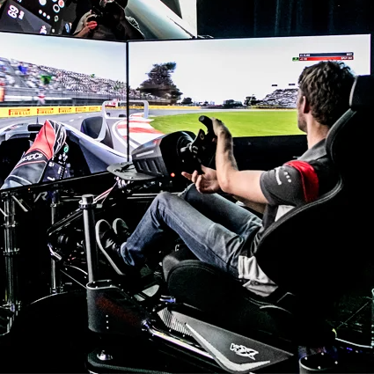
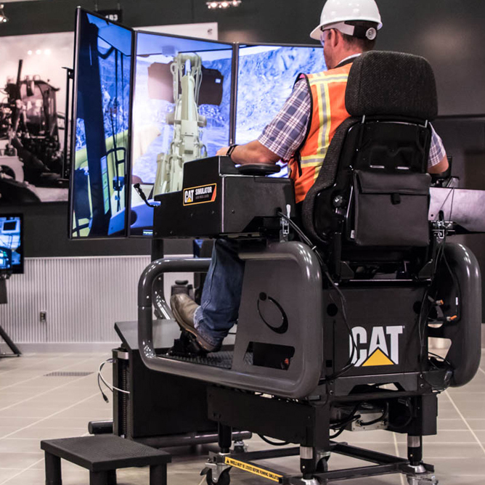
Our Strategic Focus
Driving profitable growth in 3 key commercial markets
Theatrical
Sim Racing
Simulation & Training

Slide 5
Record High Annual Revenues
($ thousands)
$39,597
Revenue growth over 2 years:
$34,122
Total revenues | +86%
System sales | +96%
Rights for use, rental & maintenance | +56%
$21,313
System sales
Rights for use, rental & maintenance
5

Slide 6
FY 2024 Adjusted EBITDA
($ thousands)
$3,056
1-year increase | 71%
2-year increase | 231%
$1,782
Adjusted EBITDA margin:
7.7%
$922
5.2%
4.3%
6

Slide 7
Record Annual Net Income
($ thousands)
$1,093
1-year increase | $2,030k
2-year increase | $2,960k
$(1,867)
$(937)
FY23
FY22
7

Slide 8
How We’ll Continue Growing
Increase penetration / sales with existing customers
Collaborate with new partners
Launch new products
Make accretive acquisitions or enter strategic partnerships
8

Slide 9
Expanding our Theatrical Footprint
748
screens
818
screens
929
screens
1,000
screens (target)
within next 12-18 months
March 31,
2022
March 31,
2023
March 31,
2024
9

Slide 10
Accelerating into Sim Racing
Boston, MA
Leverage strong partnerships with FIA, NASCAR, and leading sim racing equipment manufacturers and resellers
Continued rollout of F1 Arcade locations by Kindred Concepts
3 locations to date; up to 30 over next few years
Washington, USA (Fall 2024)
Las Vegas, USA (2025)
10

Slide 11
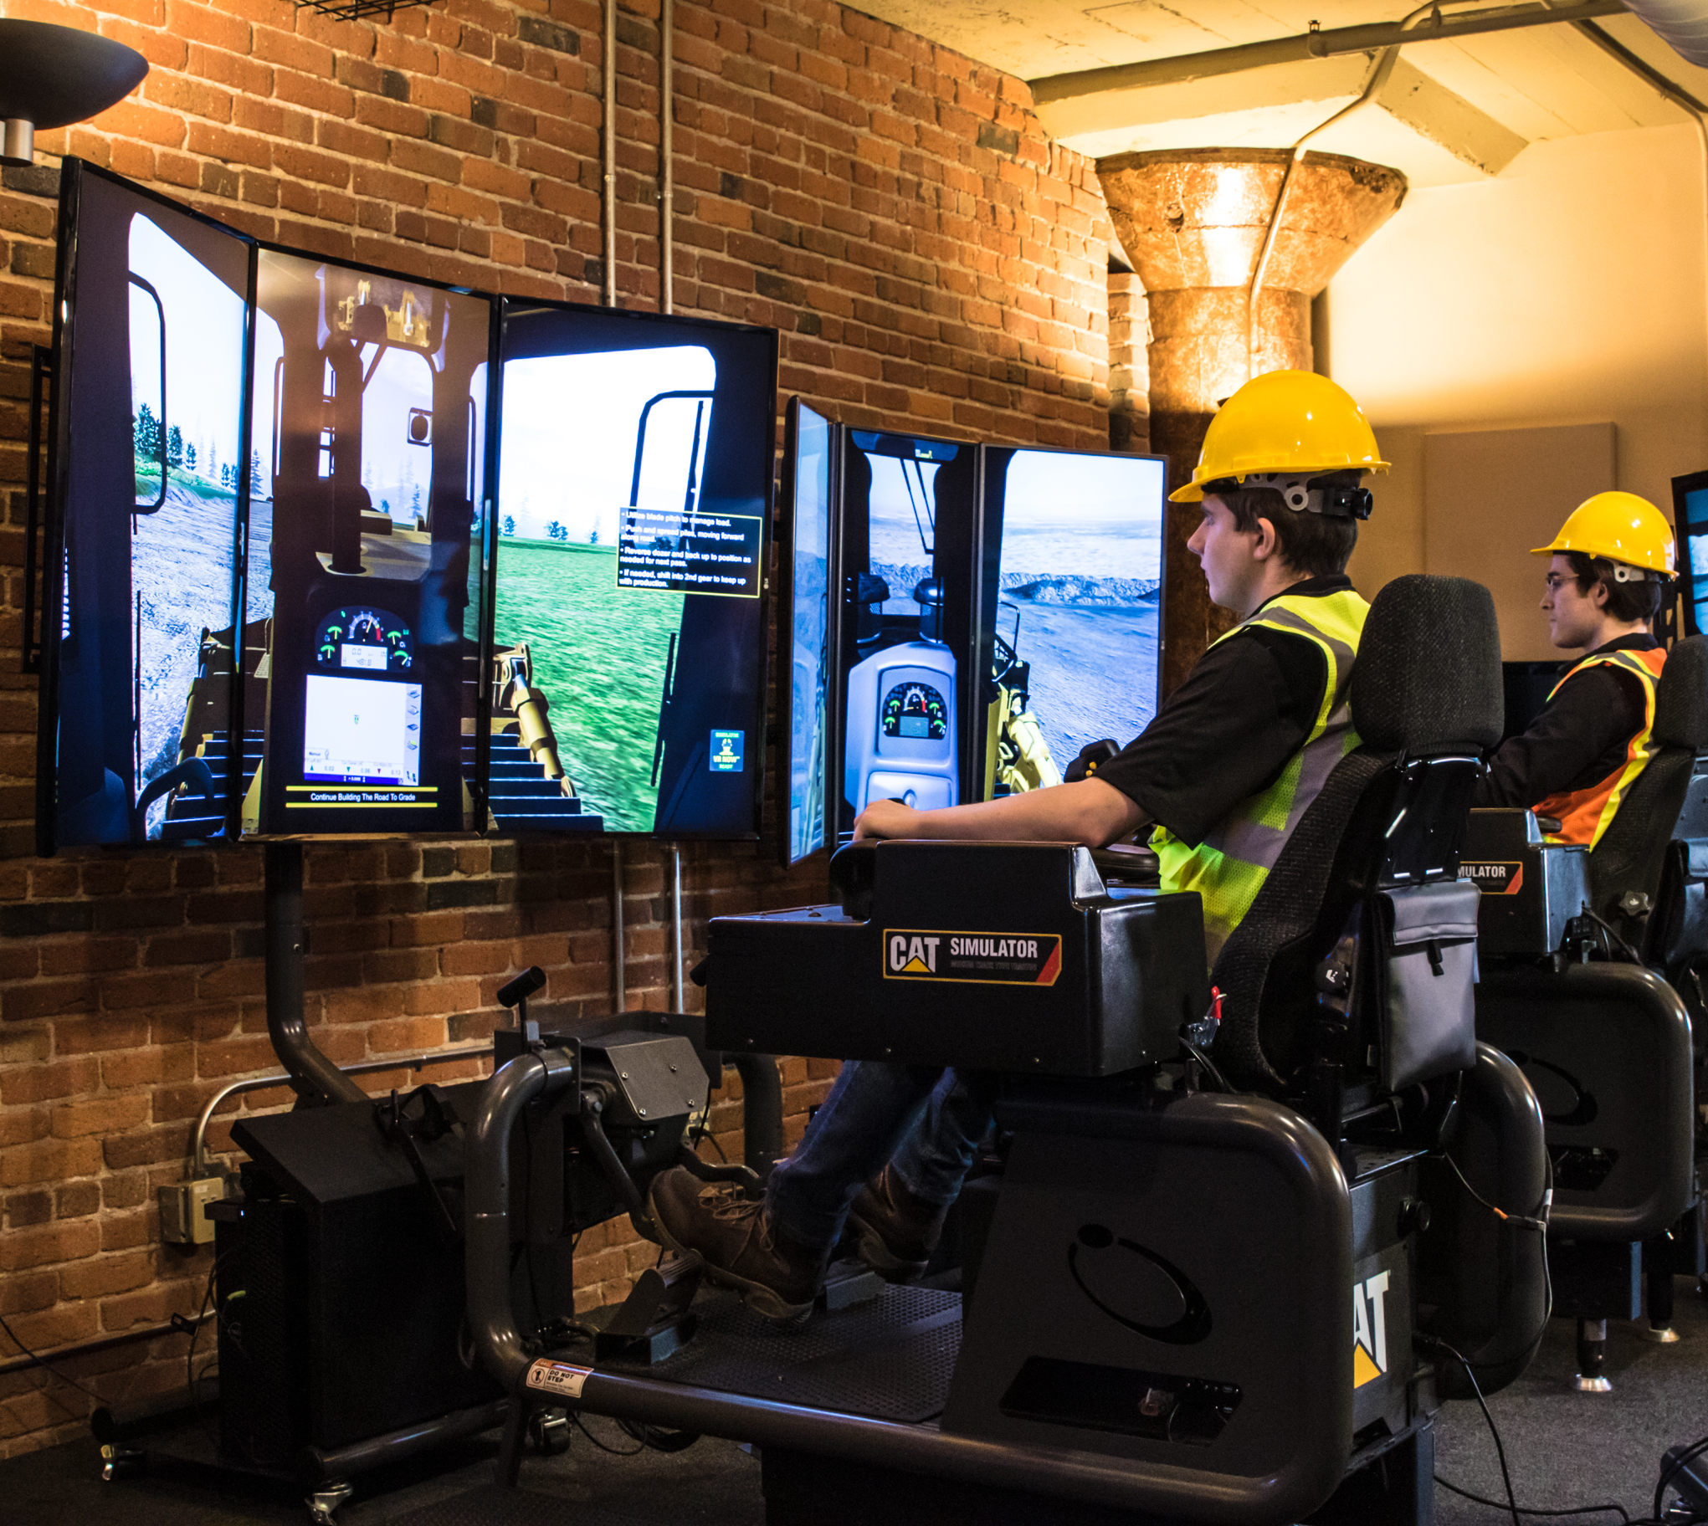
Leaning into Simulation & Training
Business opportunity
Static simulator conversion
Desktop training
Smaller footprint simulator
Key segments considered
Heavy equipment/construction
Driving
Flight
11

Slide 12
Summary
Innovative, highly precise and immersive haptic technology improves entertainment and training experiences
Strong partners in key markets: theatrical-exhibition, video gaming, and racing simulation
Looking to accelerate growth organically and through accretive acquisitions
Stock is hovering below the radar
Trading at ~0.5X sales; no analyst coverage

Slide 13
For more information:
Visit d-box.com
Email investors@d-box.com
Follow us on LinkedIn at linkedin.com/company/d-box-technologies

